Slide 1

peTree :- An Online Pet House
Mitali S. Chaudhari - 20104104
Sakshi V. Parab - 20104059
Shreyash U. Ghute - 20104051
Project Guide
Ms. Sonal Jain

Slide 2
Contents
Introduction
Objectives
Scope
Literature Survey
Proposed System
Project Outcomes
Block Diagram
Use Case/DFD
Technology Stack
Suggestions in Review-1
Result and Discussion
References

Slide 3
1. Introduction
The act of adopting an animal is a kind and selfless one that will surely bring you much love and joy.
Giving that rescue animal a second chance at life will mean the world to them. They will continue to teach you each day and make you the see the world differently.
We, tend to give these animals a new, good and healthy life by starting our website peTree.
Here, we help the people trying to adopt a pet through our site.
We would have various facilities that would lead to a good upbringing and a better life of the animal.
Veterinary Doctors would be available for the pets throughout.
For the grooming and styling of the pet, peTree too provides a commercial site that would be filled with ample amount of grooming and styling products.

Slide 4
Problems Identified in the current world that adopters face while trying to adopt a pet are….
    Different websites for pets shopping and their essentials.
    No pet training given prior adoption.
    No extra services provided by the adoption centres.

Slide 5
2. Objectives
To build an online pet house which will be user friendly.
To provide facilities of veterinarian to the customers who adopt pets from our platform.
To give training sessions to the customers who are new to adopt a pet.
To let pet lovers search for fur babies online that they can adopt.
Best products with multiple varieties and designs and assurance of the quality.
To manage all the information about customers and their reviews/feedbacks.

Slide 6
3. Scope
Can be useful for potential adopters to find a pet a pet that fits their lifestyle.
Can transform pet adoption processes into an easy, fast and convenient way.
Can be helpful to the willing pet adopters who don’t find adoption centers near them.
Can become a time saving hero, being a one-stop shop for adoption as-well-as shopping.
Can become a source of employment for many people (pet trainers, Vet. Doctors, online retailers….etc.)

Slide 7
4. Literature Survey
Case 1:
In the year 2016, a research paper was published by authors Jannete Young and Lisel O’Dwyer, which discussed about the Mental Health of the Animals. This survey seeks to pull threads from across this diversity of literature summarizing what we now know about pets and mental health and how this knowledge could be used for mental health promotion of animals.
Case 2:
Recently in 2018, a group of Australian students made a Follow-up-Survey of people who adopted pets. This study assessed the degree of satisfaction among individuals whom had adopted a cat or a dog. The survey also assessed the adopted animals' health, behavior and interactions with children and other pets residing in the household.
Summarizing, this survey assessed the adoption satisfaction of the adopters.

Slide 8
5. Proposed System
peTree is one stop online shop for pets adoption and their products.
This platform gives the training to the parents virtually as well as physically (if requested).
Various options of selecting pets from a variety of breeds.
Parenting Test & training.
Veterinarian services & other health cares.
Pet Essentials like grooming, toys, beds, food, clothes, bowls and feeders etc.
Services like Pet Day-care ,Vaccination, etc. are provided collaborating with other websites.

Slide 9
6. Outcome of Project
User can select the pet of his/her choice from the varieties available.
User has the choice of buying various pet accessories from the shopping section.
He/she will get the Doctors appointment and the further consultations abut the healthcare of the pet.
The new adopters will get trained if don’t have any experience of having any pets.
Adopters will have a variety of services provided.
User can give feedback about the service provided etc.

Slide 10
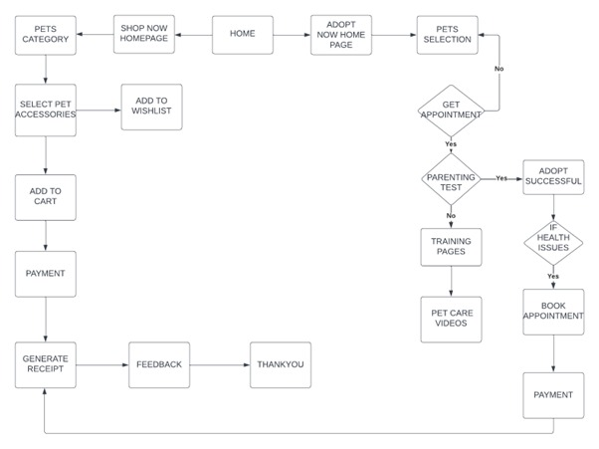
7. Block Diagram

Slide 11
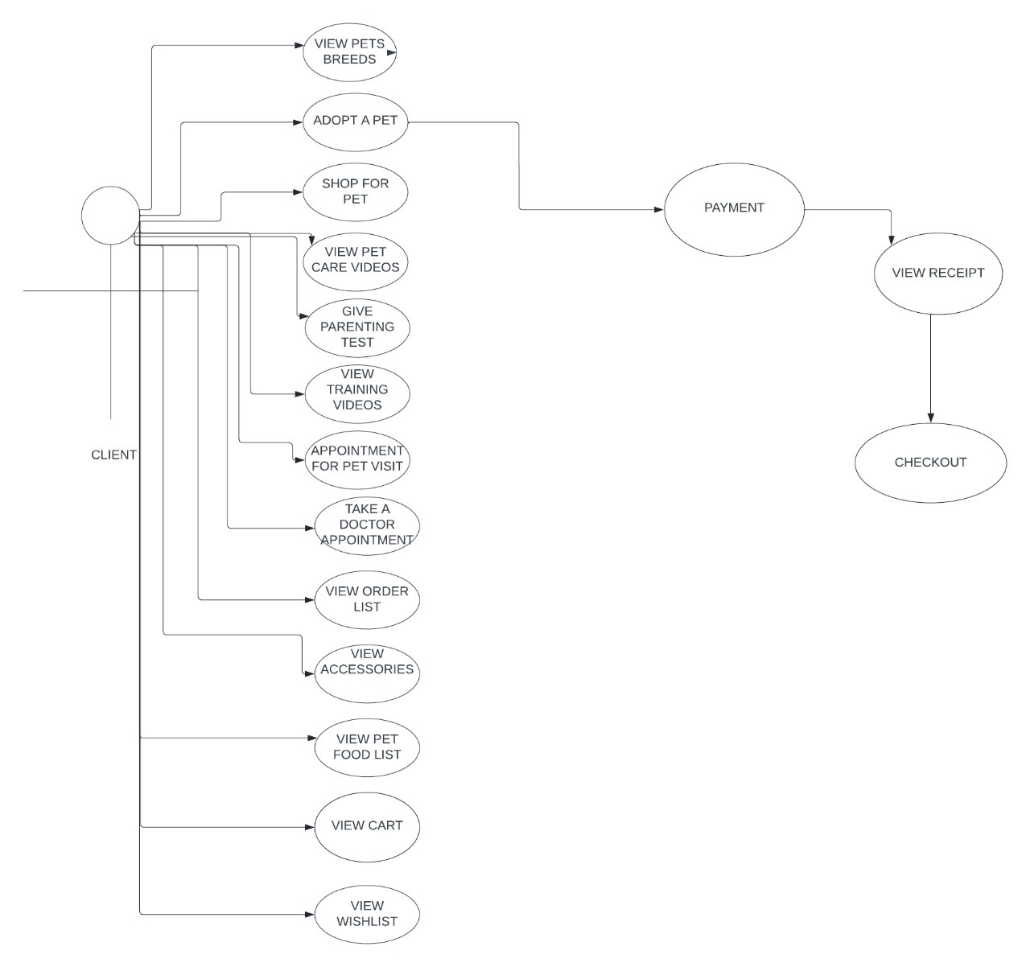
8. Use Case/Data Flow Diagram

Slide 12
9. Technology Stack
Frontend (GUI):- HTML
CSS
JAVASCRIPT
BOOTSTRAP
Backend :- FIREBASE

Slide 13
10. Suggestions in Review-1
1. Need to have a proper block diagram.
2. Building of a doctors page.
3. Addition of a literature survey.
4. Building a proper footer with the right contents.

Slide 14
11. References
1. Jannete Young and Lisel O’Dwyer (2016),Mental Health of Animals.
2. Australian Institute Of Health and Welfare(2018),Follow-up survey of pet parents.
3. Kidd A. and Kidd R,(1994),Benefits and liabilities of pets for the homeless.

Slide 15
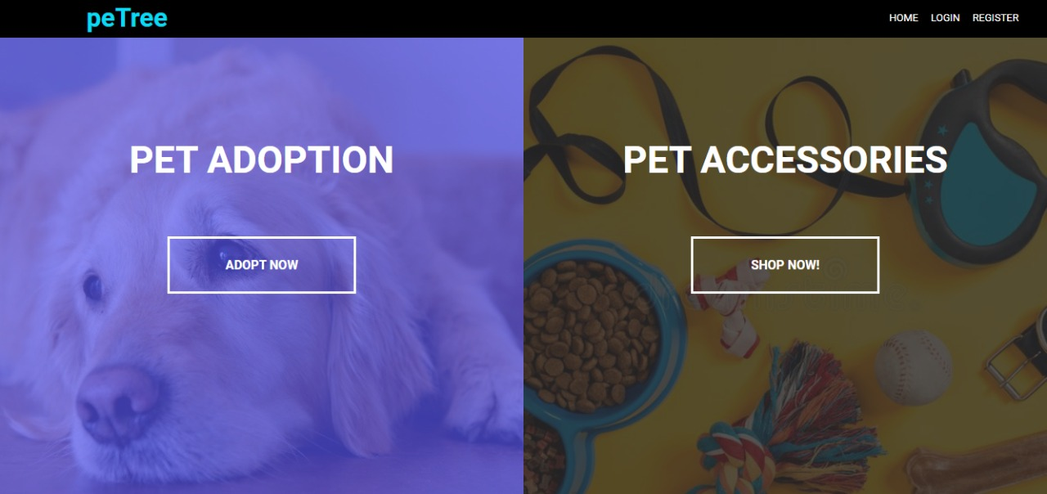
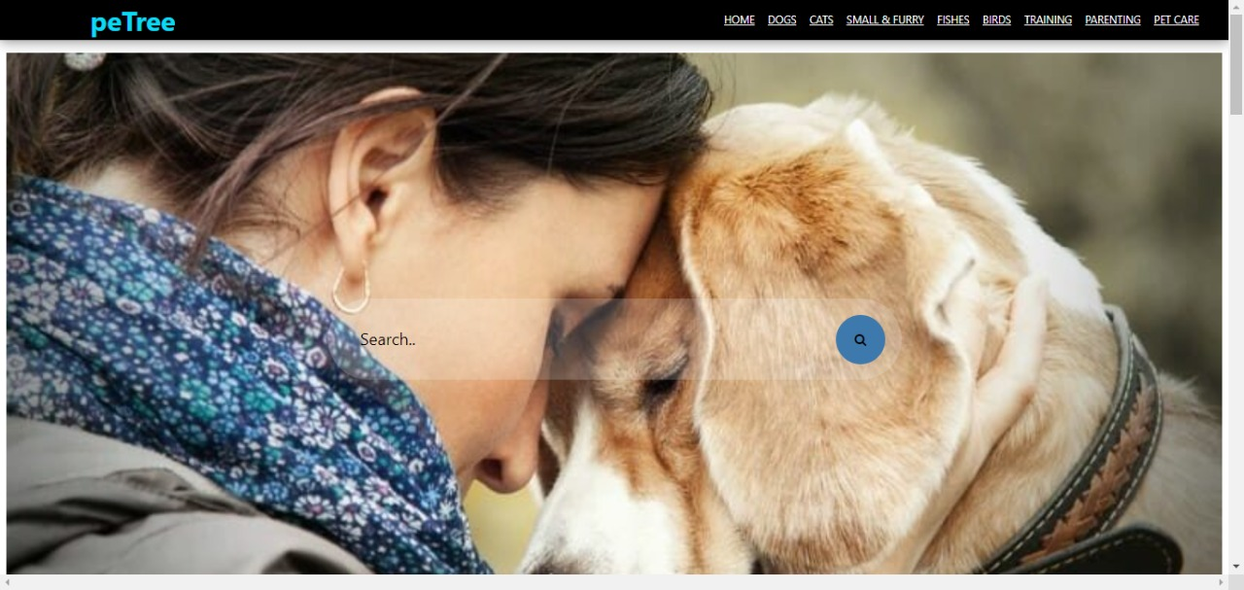
12. Result and Discussion
Home page:
Adoption Home Page:

Slide 16
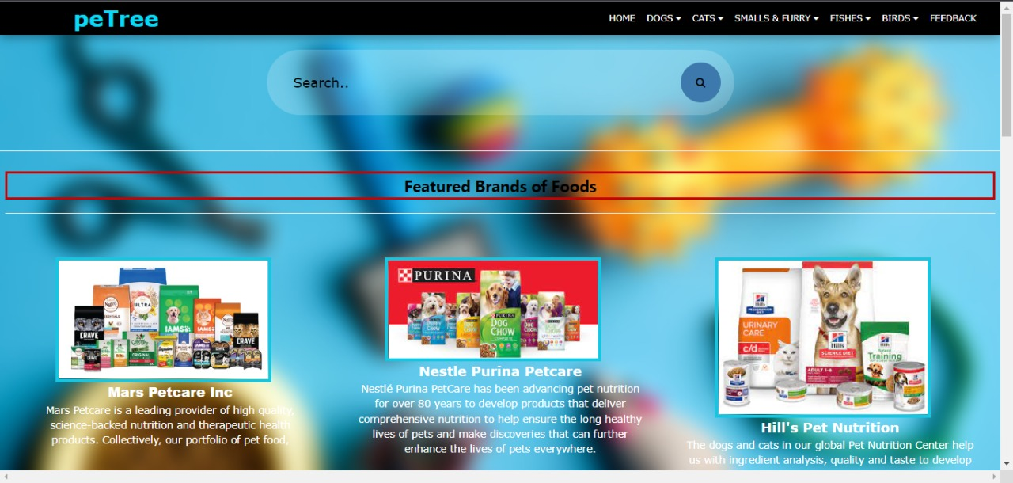
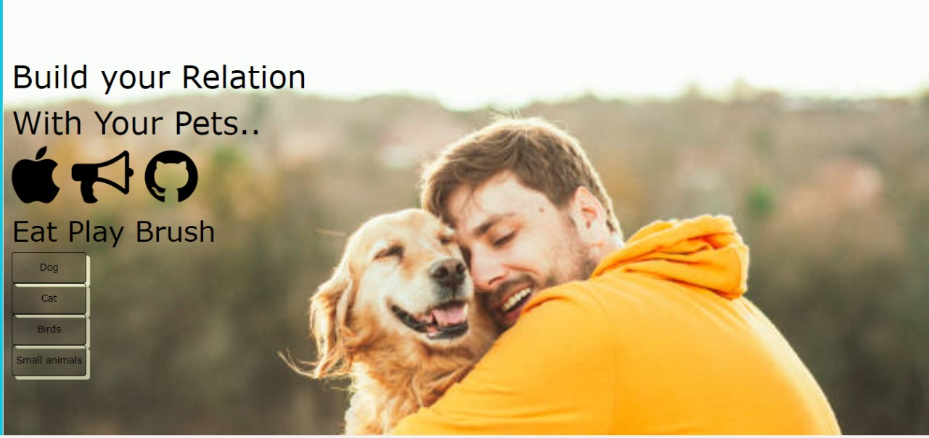
Commercial Site Page:
Training Page:

Slide 17
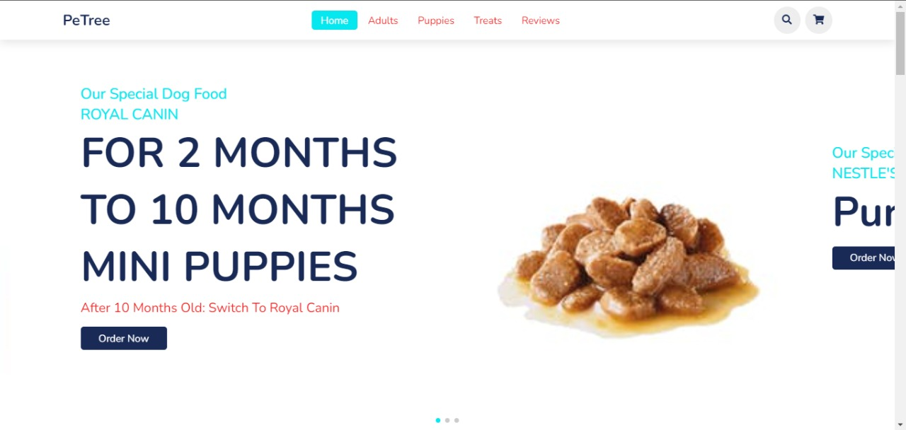
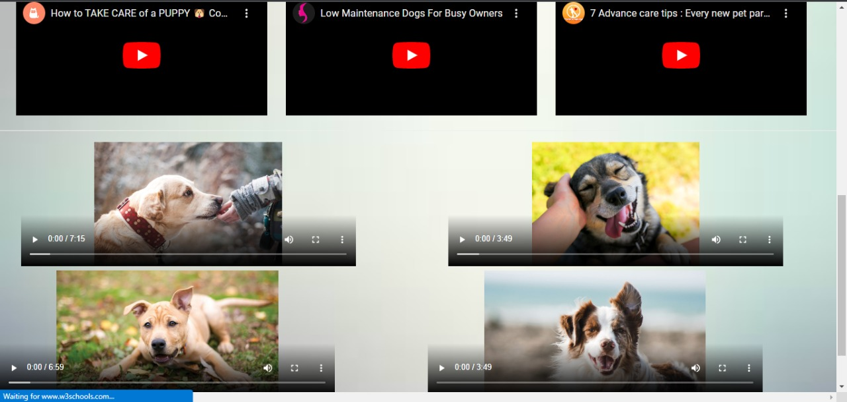
Shopping items:
Healthcare help:

Slide 18
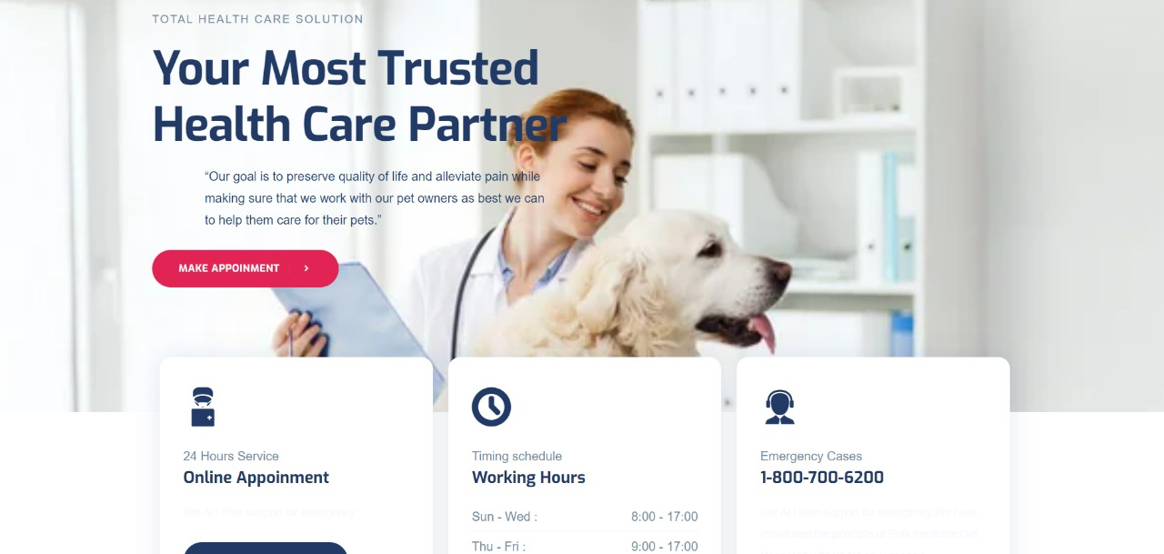
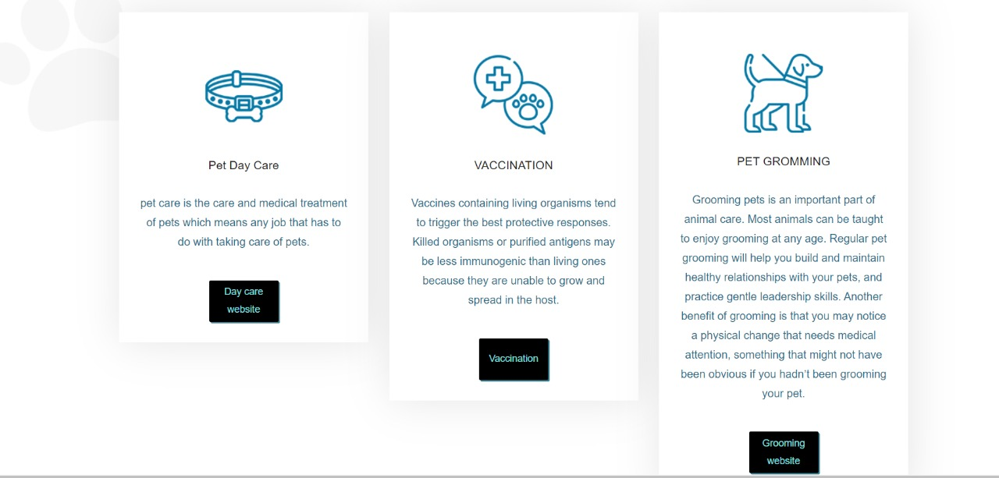
Doctors Page:
Service Page:

Slide 19
Thank You...!!

